Slide 1
Class 8: Probabilistic weather forecasting with NNs via scoring rules

Slide 2
Outline
Motivation & Calibration
Proper scoring rules: Brier, Log, CRPS
Calibration & sharpness diagnostics
CNN architectures for probabilistic outputs
LSTM architectures for probabilistic outputs
Manual & framework implementations
Training results & calibration diagrams
Ensembles, hyperparameters & variants
Applications & best practices
Summary & further reading

Slide 3
Motivation
Point
Deterministic forecasts provide a single point estimate
Probabilistic forecasts assign a distribution to the future – essential for risk‑aware decisions
Calibration measures statistical consistency between predicted and observed distributions
Sharpness reflects the concentration of the predictive distribution; the goal is sharp and calibrated forecasts
Distribution

Slide 4
Proper scoring rules
Scoring rules evaluate probabilistic forecasts by comparing the predicted distribution to the observed value
A scoring rule is strictly proper if the expected score is minimised when the forecast distribution equals the true distribution
Proper scoring rules encourage calibration and discourage hedging – making too conservative forecasts
Popularised by Gneiting and Raftery (2007)
Model | Mean | Std deviation | Observation | Scoring rule | MSE
A | 20°C | 1°C | 19°C | 1.42 | 1
B | 20°C | 3°C | 19°C | 1.94 | 1
Notes:
If you use Mean Absolute Error (MAE) as a loss function, the "optimal" strategy for the model is to predict the median. If you use Mean Squared Error (MSE), it predicts the mean. Only proper scoring rules like CRPS force the model to estimate the entire distribution honestly.

Slide 5
Calibration and sharpness
Reliability: predicted probabilities match observed frequencies
Sharpness: predictive distributions are as concentrated as possible
Aim: reliability diagrams close to diagonal and narrow prediction intervals
Reliability diagram

Slide 6
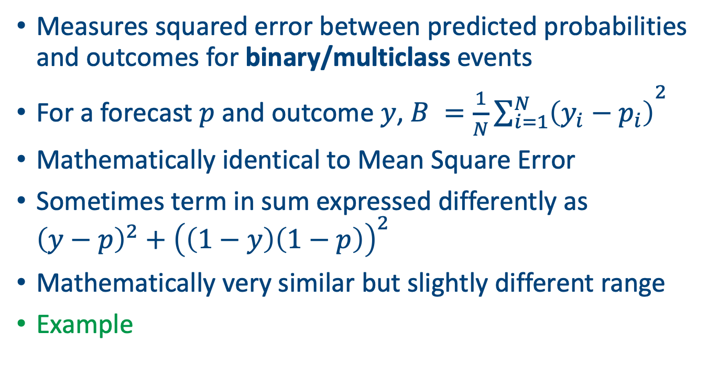
Brier score
Measures squared error between predicted probabilities and outcomes for binary/multiclass events
For a forecast $p$ and outcome $y$, $B ={\frac{1}{N}\sum_{i=1}^{N}{\left(y_{i}−p_{i}\right)}}^{2}$
Mathematically identical to Mean Square Error
Sometimes term in sum expressed differently as ${\left(y−p\right)}^{2}+{\left(\left(1−y\right)\left(1−p\right)\right)}^{2}$
Mathematically very similar but slightly different range
Example
Notes:
Reasoning: $(0.5 - 1)^2 = 0.25$ and $(0.5 - 0)^2 = 0.25$. Since rain happens 50% of the time, the average score is $0.25$. This teaches students that a Brier Score can be "okay" while the forecast is still "unsharp" (uninformative).

Slide 7
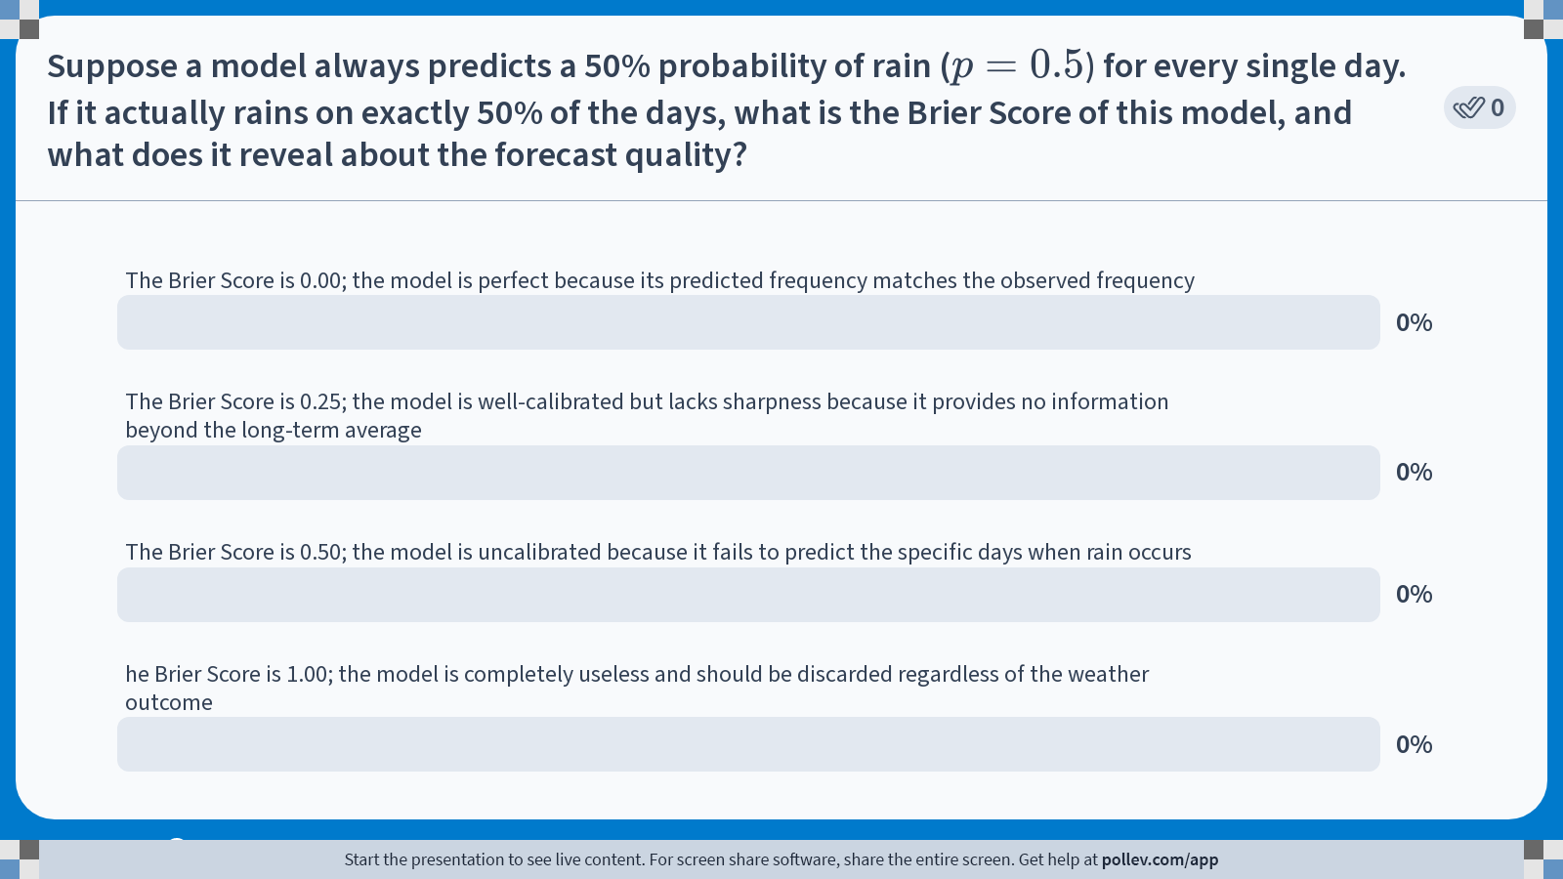
Notes:
Do not modify the notes in this section to avoid tampering with the Poll Everywhere activity. More info at polleverywhere.com/support Suppose a model always predicts a 50% probability of rain ($$p = 0.5$$) for every single day. If it actually rains on exactly 50% of the days, what is the Brier Score of this model, and what does it reveal about the forecast quality?
https://www.polleverywhere.com/multiple_choice_polls/vd3UrKUYILga0TJnv0kQ2?state=opened&flow=Default&onscreen=persist

Slide 8
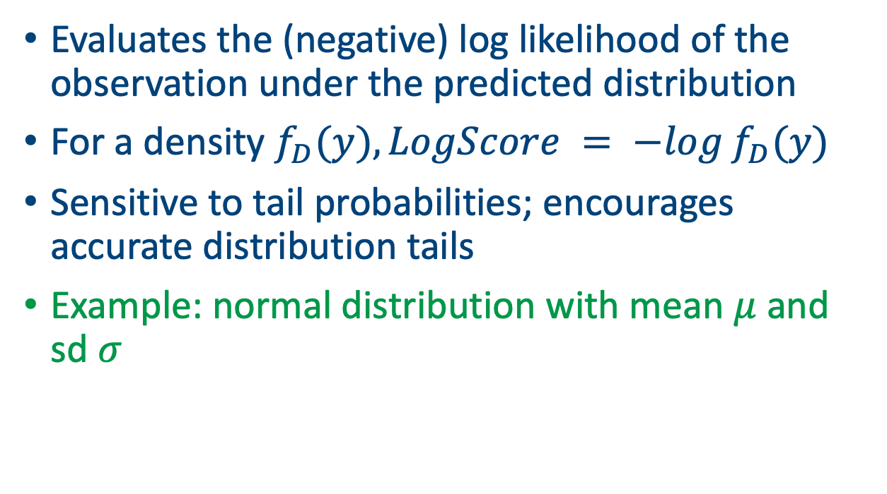
Logarithmic score
Evaluates the (negative) log likelihood of the observation under the predicted distribution
For a density $f_{D}(y), LogScore = −log⁡f_{D}(y)$
Sensitive to tail probabilities; encourages accurate distribution tails
Example: normal distribution with mean $μ$ and sd $σ$

Slide 9
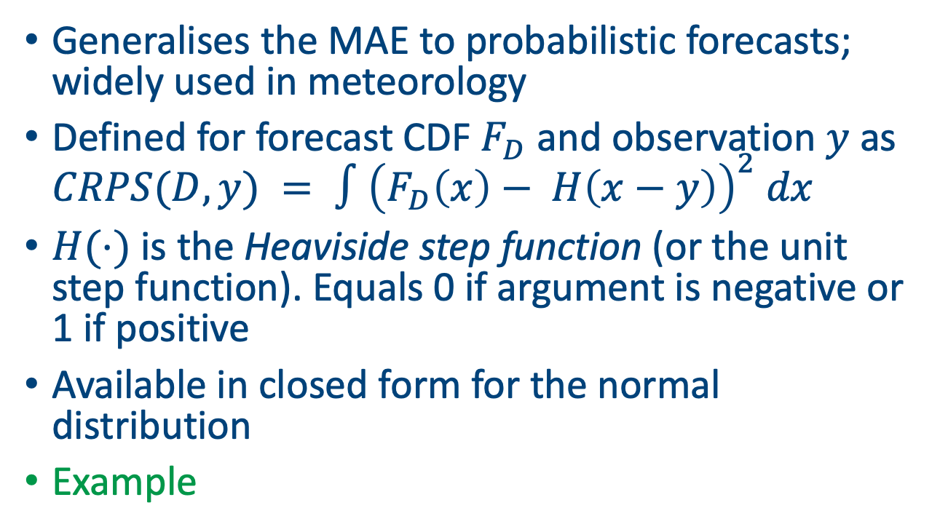
Continuous ranked probability score (CRPS)
Generalises the MAE to probabilistic forecasts; widely used in meteorology
Defined for forecast CDF $F_{D}$ and observation $y$ as $CRPS(D,y) = ∫{\left(F_{D}\left(x\right)− H\left(x−y\right)\right)}^{2} dx$
$H(⋅)$ is the Heaviside step function (or the unit step function). Equals 0 if argument is negative or 1 if positive
Available in closed form for the normal distribution
Example

Slide 10
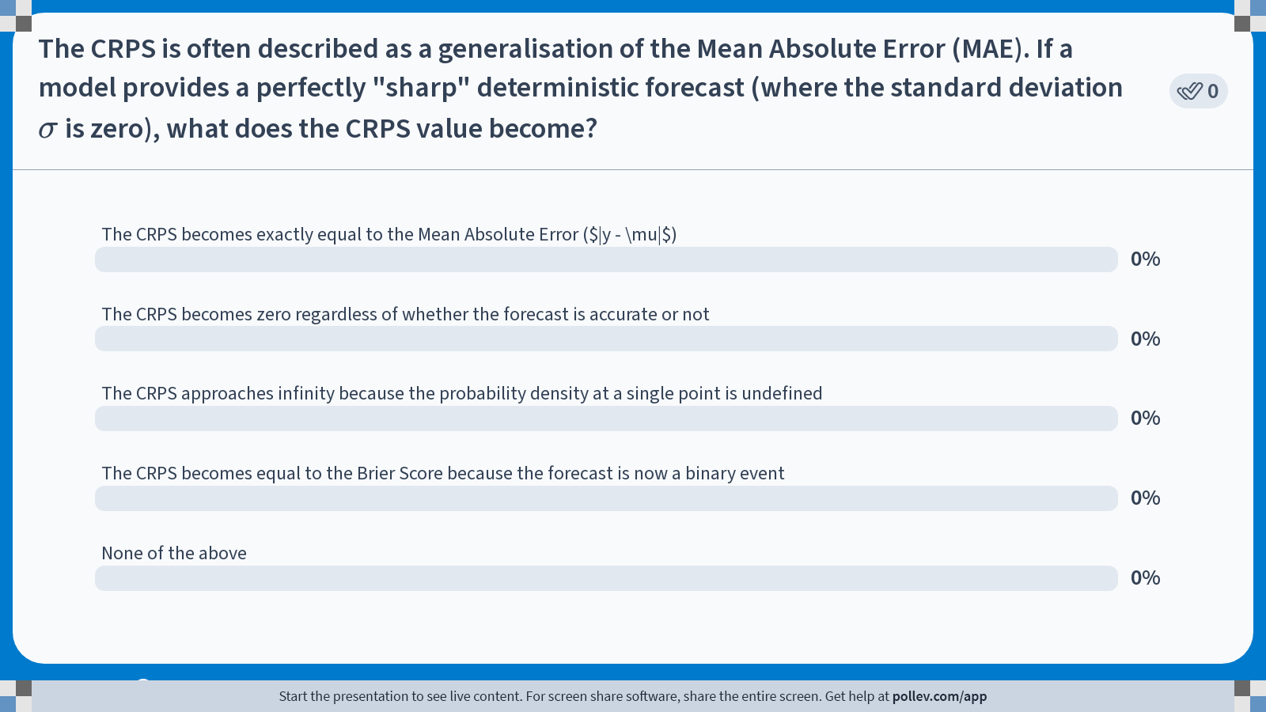
Notes:
Do not modify the notes in this section to avoid tampering with the Poll Everywhere activity. More info at polleverywhere.com/support The CRPS is often described as a generalisation of the Mean Absolute Error (MAE). If a model provides a perfectly "sharp" deterministic forecast (where the standard deviation $$\sigma$$ is zero), what does the CRPS value become?
https://www.polleverywhere.com/multiple_choice_polls/P3B4HihRUR32bagwfF4v6?state=opened&flow=Default&onscreen=persist

Slide 11
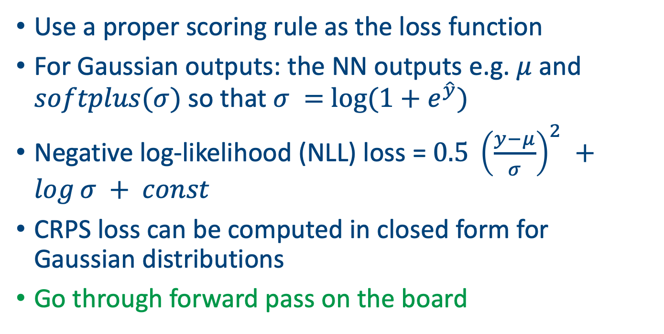
Probabilistic Output Layers
Use a proper scoring rule as the loss function
For Gaussian outputs: the NN outputs e.g. $μ$ and $softplus(σ)$ so that $σ =$ $log(1+e^{\hat{y}})$
Negative log-likelihood (NLL) loss = $0.5 {\left(\frac{y−μ}{σ}\right)}^{2} +log⁡σ + const$
CRPS loss can be computed in closed form for Gaussian distributions
Go through forward pass on the board

Slide 12
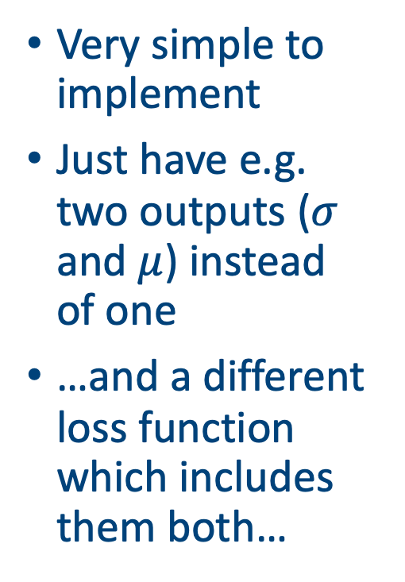
Probabilistic forecasting in PyTorch
Very simple to implement
Just have e.g. two outputs ($σ$ and $μ$) instead of one
…and a different loss function which includes them both…
class TinyProbNN(nn.Module):
def __init__(self):
super().__init__()
self.h = nn.Linear(1, 1) # one hidden neuron
self.out = nn.Linear(1, 2) # [mu, raw_sigma]
def forward(self, x):
h = F.relu(self.h(x))
mu, raw_sigma = self.out(h).chunk(2, dim=1)
# ensure positivity; softplus is numerically stable
sigma = F.softplus(raw_sigma) + 1e-6
return mu, sigma

Slide 13
PyTorch part 2
def gaussian_nll(y, mu, sigma):
# NLL = 0.5*log(2πσ^2) + (y-μ)^2 / (2σ^2)
return 0.5*torch.log(2*math.pi*sigma**2) + 0.5*((y - mu)**2)/(sigma**2)
for epoch in range(1000):
mu, sigma = model(x)
loss = gaussian_nll(y, mu, sigma).mean()
opt.zero_grad()
loss.backward()
opt.step()

Slide 14
Adding probabilistic forecasting to other models
We can use this with LSTMs or Transformers to produce probabilistic forecasts of the next time step
Just add the extra layers to the head and adjust the loss function to a proper scoring rule
Be sure to check that your output makes sense
Can be applied to all the other models we have met (and many more that we haven’t)

Slide 15
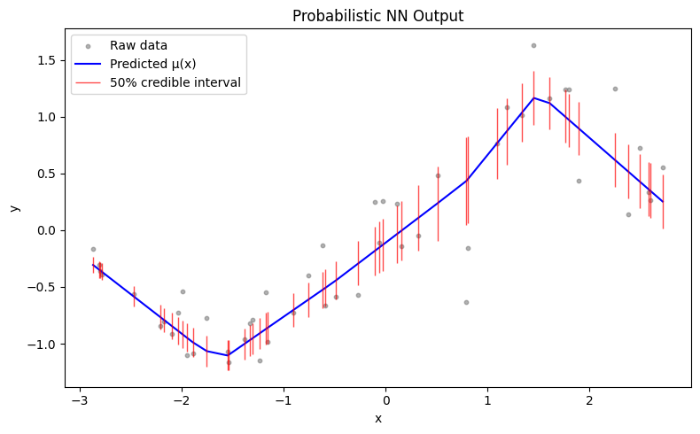
Example: simple ANN with PyTorch
Created via Super_simple_probabilistic_ANN.ipynb

Slide 16
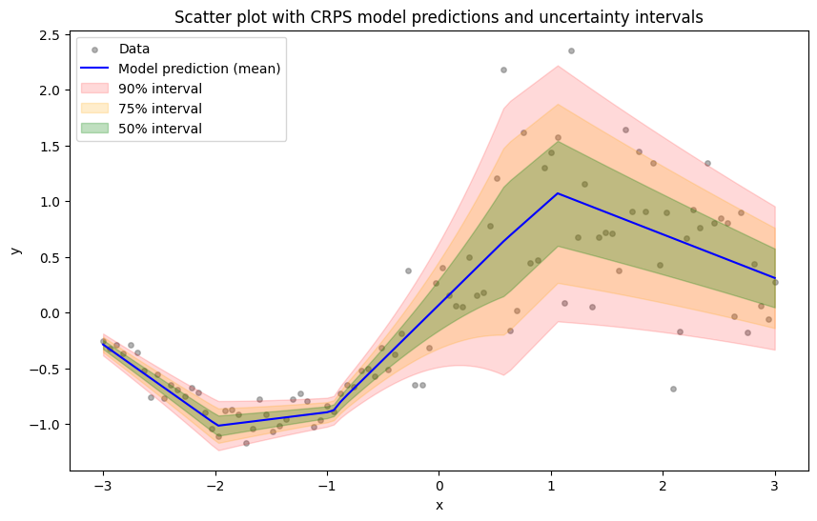
Pytorch results from CRPS fit
Created via Super_simple_CRPS_ANN.ipynb

Slide 17
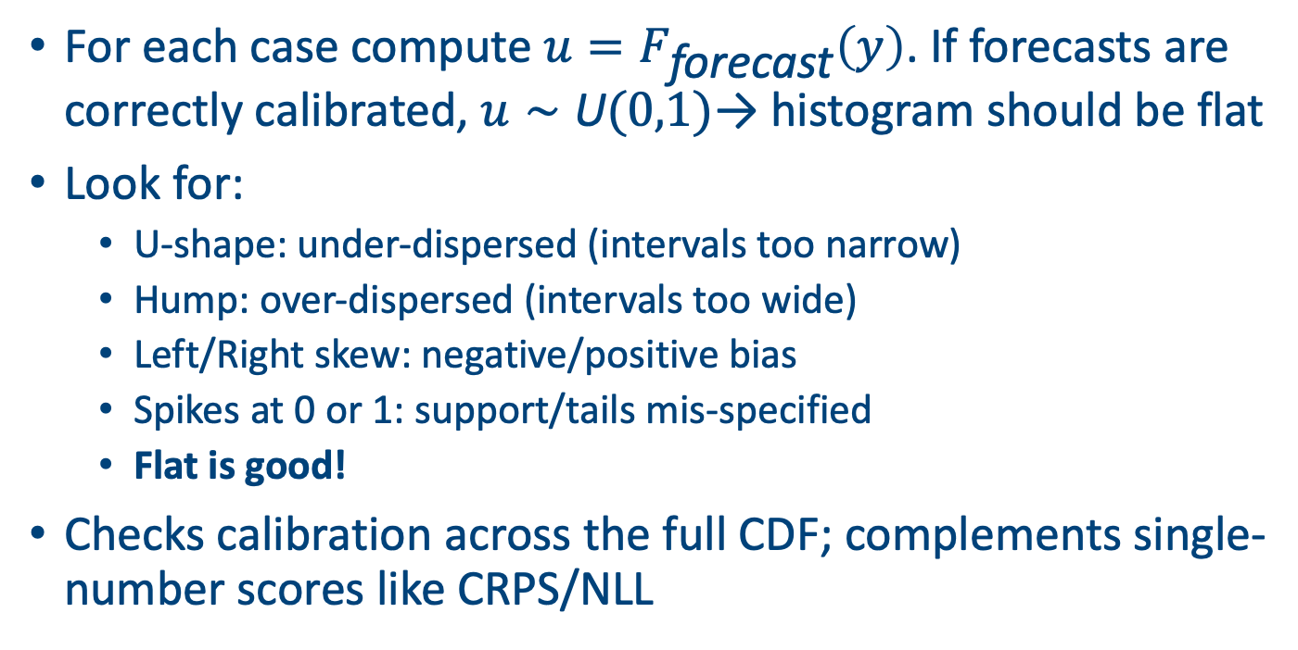
The Probability Integral Transform (PIT) Histogram
For each case compute $u=F_{\text{forecast}}\left(y\right)$. If forecasts are correctly calibrated, $u∼\text{U}(0,1)$→ histogram should be flat
Look for:
U-shape: under-dispersed (intervals too narrow)
Hump: over-dispersed (intervals too wide)
Left/Right skew: negative/positive bias
Spikes at 0 or 1: support/tails mis-specified
Flat is good!
Checks calibration across the full CDF; complements single-number scores like CRPS/NLL

Slide 18
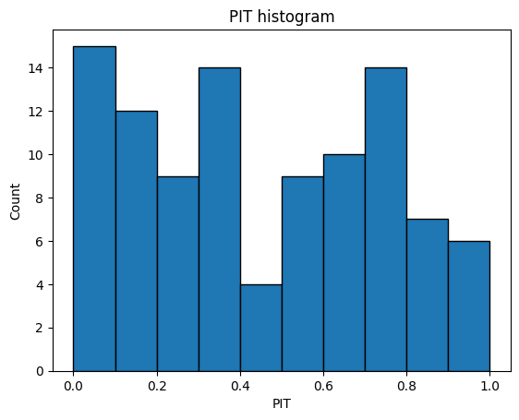
The PIT for our data
A bit skewed
Might need a richer model?
Increase the number of hidden layers or the complexity of the NN

Slide 19
Other approaches
Mixture Density Networks (MDN): output mixture weights, means & variances
Quantile Regression Networks: output specific quantiles using pinball loss
Generative models (GANs/VAEs): sample entire distributions
Bayesian neural networks: place priors over weights to capture uncertainty

Slide 20
Model averaging and ensembles
Averaging multiple models can improve calibration and sharpness
Use ensembles of CNNs/LSTMs trained with different initialisations
Alternatively combine models (including deterministic models) with probabilistic postprocessing (e.g., quantile regression)
Average CRPS (lower is better)

Slide 21
Limitations of probabilistic forecasting
Heavy tails and extreme events are difficult to model accurately
Probabilistic calibration may fail under distributional shift
Large computational cost of training CRPS/NLL losses for large models
Can be harder to interpret and communicate probabilistic forecasts to stakeholders

Slide 22
Summary
Probabilistic forecasts quantify uncertainty and enable risk‑aware decisions
Proper scoring rules (Brier, Log, CRPS) provide objective loss functions that encourage calibration
CNNs and LSTMs can be extended to output distribution parameters and trained with these scoring rules
Calibration diagnostics (reliability diagrams, PIT histograms) are essential to evaluate forecasts
Ensembles, proper hyperparameter tuning, and advanced models further improve probabilistic forecasts

Slide 23
Topics we haven’t covered
Reinforcement learning: Learns policies via trial and error to potentially change how the model produces forecasts
Diffusion models: a generative approach that maps noise to e.g. realistic atmospheric states; enable ensemble generation, downscaling, and calibrated post-processing
Transfer learning: Leverages pretrained models or neighboring regions to boost weather forecasts when e.g. station data are scarce
Extremal NNs: Changing the loss function to match either univariate or (even better) multivariate extreme value models

Slide 24
Next class
Run through D4C3_code.ipynb

Slide 25

Feedback please
https://forms.gle/7FTGrtsM6r9B3MXR8

Slide 26
Afternoon session instructions
Use some of the data sets in the data directory (or download your own)
Get an LLM to help you write a graph attention network to predict multiple variables across multiple slides
Stay small!
Present your file in 5 minutes

